Slide 1
CHAPTER-9
Strategic Management
Copyright © 2005 Prentice Hall, Inc. All rights reserved.
8–<number>

Slide 2

Strategic Management
The set of managerial decisions
and actions that determines an organization’s strategies and its
long-run performance.
It involves all the basic
management functions.
What does “strategy” mean?
Copyright © 2005 Prentice Hall, Inc. All rights reserved.
8–<number>

Slide 3
Why Strategic Management Is Important
It can make a difference in how well an organization performs.
Research shows: strategic planning α performance
It enables managers to examine and adapt to business environment changes. [Remember, we talked about the environment being complex and dynamic].
3. It coordinates diverse organizational units, helping them focus on organizational goals.
Copyright © 2005 Prentice Hall, Inc. All rights reserved.
8–<number>

Slide 4
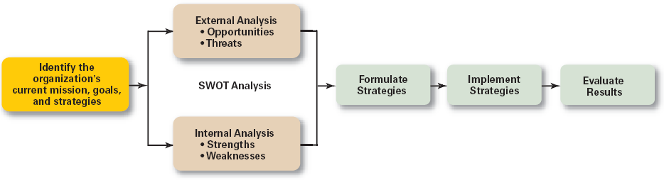
The Strategic Management Process
Copyright © 2005 Prentice Hall, Inc. All rights reserved.
Exhibit 8.1
8–<number>

Slide 5
Strategic Management Process
Step 1: Identifying the organization’s current mission, objectives, and strategies
  Mission: the firm’s reason for being
    The scope of its products and services
  Goals: the foundation for further planning
    Measurable performance targets
Step 2: Conducting an external analysis
  The environmental scanning of specific and general environments
    Focuses on identifying opportunities and threats
Copyright © 2005 Prentice Hall, Inc. All rights reserved.
8–<number>

Slide 6
Strategic Management Process (cont’d)
Step 3: Conducting an internal analysis
  Assessing organizational resources, capabilities, activities, and culture:
    Strengths (core competencies) create value for the customer and strengthen the competitive position of the firm.
    Weaknesses (things done poorly or not at all) can place the firm at a competitive disadvantage.
Steps 2 and 3 combined are called SWOT analysis. (Strengths, Weaknesses, Opportunities, and Threats)
Copyright © 2005 Prentice Hall, Inc. All rights reserved.
8–<number>

Slide 7
Strategic Management Process (cont’d)
Step 4: Formulating strategies
  Develop and evaluate strategic alternatives
  Select appropriate strategies for all levels in the organization that provide relative advantage over competitors
  Match organizational strengths to environmental opportunities
  Correct weaknesses and guard against threats
  There are three main types of strategies: corporate, business and functional.
Copyright © 2005 Prentice Hall, Inc. All rights reserved.
8–<number>

Slide 8
Strategic Management Process (cont’d)
Step 5: Implementing strategies
  Implementation: effectively fitting organizational structure and activities to the environment
Step 6: Evaluating Results
  How effective have strategies been?
  What adjustments, if any, are necessary?
Copyright © 2005 Prentice Hall, Inc. All rights reserved.
8–<number>

Slide 9

Types of Organizational Strategies
Corporate Strategy
  It specifies what businesses a company is in or wants to be in and what it wants to do with those businesses. It’s based on the mission and goals of the organization and the roles that each business unit of the organization will play.
Types of Corporate Strategies
  Growth: expansion into new products and markets
  Stability: maintenance of the status quo
  Renewal: strategies to address declining performance
Copyright © 2005 Prentice Hall, Inc. All rights reserved.
8–<number>

Slide 10

Corporate-Level Strategies
Growth Strategy
  Seeking to increase the organization’s business by expansion into new products and markets.
Types of Growth Strategies
  Concentration
  Vertical integration – both backward and forward
  Horizontal integration
  Diversification – related or unrelated
Copyright © 2005 Prentice Hall, Inc. All rights reserved.
8–<number>

Slide 11

Growth Strategies
Concentration
  Focusing on a primary line of business and increasing the number of products offered or markets served.
Vertical Integration
  Backward vertical integration: attempting to gain control of inputs (become a self-supplier).
  E.g. Amazon.com backward vertically integrated when it became not only a bookseller but a book publisher.
  Forward vertical integration: attempting to gain control of output through control of the distribution channel and/or provide customer service activities (eliminating intermediaries).
8–<number>

Slide 12
Growth Strategies (cont’d)
Horizontal Integration
  Combining operations with another competitor in the same industry to increase competitive strengths and lower competition among industry rivals.
  E.g. Heinz and Kraft Foods merged into one company in 2015. Both produce processed food for the consumer market.
Related Diversification
  Expanding by merging with or acquiring firms in different, but related industries that are “strategic fits”.
  e.g. a manufacturer of computers might begin making calculators as a form of related diversification of its existing business.
Unrelated Diversification
  Growing by merging with or acquiring firms in unrelated industries where higher financial returns are possible.
Copyright © 2005 Prentice Hall, Inc. All rights reserved.
8–<number>

Slide 13
Stability Strategy
  A strategy that seeks to maintain the status quo i.e. continue to do what the company is currently doing.
  Renewal Strategy
  Developing strategies to counter organization weaknesses that are leading to performance declines.
    Retrenchment: focusing of eliminating non-critical weaknesses and restoring strengths to overcome current performance problems.
    Turnaround: addressing critical long-term performance problems through the use of strong cost elimination measures and large-scale organizational restructuring solutions.
Copyright © 2005 Prentice Hall, Inc. All rights reserved.
8–<number>

Slide 14
Competitive Strategies
A competitive strategy is a strategy for how an organization will compete in its business (es).
For businesses with only one line of business, the competitive strategy describes how it will compete in its primary or main market.
For companies with multiple businesses, each business has its own competitive strategy that defines its competitive advantage, the products or services it will offer, the customers it wants to reach, and as such.
Copyright © 2005 Prentice Hall, Inc. All rights reserved.
8–<number>

Slide 15
The Role of Competitive Advantage
Competitive Advantage
  An organization’s distinctive competitive edge which differentiates a company from its competitors.
Quality as a Competitive Advantage
  Differentiates the firm from its competitors.
  Can create a sustainable competitive advantage.
  Represents the company’s focus on quality management to achieve continuous improvement and meet customers’ demand for quality.
Copyright © 2005 Prentice Hall, Inc. All rights reserved.
8–<number>

Slide 16

The Role of Competitive Advantage (cont’d)
Sustainable Competitive Advantage
  Continuing over time to effectively exploit resources and develop core competencies that enable an organization to keep its edge over its industry competitors.
Copyright © 2005 Prentice Hall, Inc. All rights reserved.
8–<number>

Slide 17
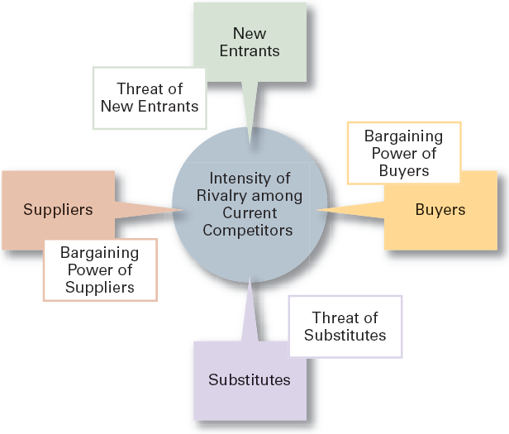
Forces in the Industry Analysis
An important part of developing competitive strategy is to conduct an industry analysis.
Porter's five forces analysis is a framework for industry analysis and business strategy development
In an industry, five competitive forces dictate the rules of competition. Together, these five forces determine industry attractiveness and profitability, which managers asses using these five factors.

Slide 18
Five Competitive Forces
Threat of New Entrants
  The ease or difficulty with which new competitors can enter an industry.
Threat of Substitutes
  The extent to which switching costs and brand loyalty affect the likelihood of customers adopting substitutes products and services.
Bargaining Power of Buyers
  How much bargaining power do buyers (customers) have?
Copyright © 2005 Prentice Hall, Inc. All rights reserved.
8–<number>

Slide 19
Five Competitive Forces
Bargaining Power of Suppliers
  How much bargaining power do suppliers have?
  Ex.: If you are making biscuits and there is only one person who sells flour, you have no alternative but to buy it from him.
Current Rivalry
  Intensity among rivals increases when industry growth rates slow, demand falls, and product prices descend.
Copyright © 2005 Prentice Hall, Inc. All rights reserved.
8–<number>

Slide 20
Competitive Strategies
Once managers have assessed the five forces and done the SWOT analysis, they are ready to select an appropriate competitive strategy.
A strategy that fits the company’s competitive strengths because no firm can be successful by trying to be all things to all people.
Managers should select a strategy that will give the organization a competitive advantage over its rival companies.
Copyright © 2005 Prentice Hall, Inc. All rights reserved.
8–<number>

Slide 21
Competitive Strategies
Cost Leadership Strategy
  Seeking to attain the lowest total overall costs relative to other industry competitors. A low cost leader is highly efficient. The firm does everything to cut costs.
  Although, a low cost leader does not provide high quality products but they are at least comparable to those offered by rivals or they must be at least be acceptable to buyers.
Copyright © 2005 Prentice Hall, Inc. All rights reserved.
8–<number>

Slide 22
Competitive Strategies
Differentiation Strategy
  Attempting to create a unique and distinctive product or service for which customers will pay a premium.
  Product differences will come from exceptionally high quality, extraordinary service, innovative design, technological capability or an unusually positive brand image.
  Practically any successful consumer product or service can be identified as an example of the differentiation strategy.
Copyright © 2005 Prentice Hall, Inc. All rights reserved.
8–<number>

Slide 23
Competitive Strategies
Focus Strategy
  Using a cost or differentiation advantage to exploit a particular market segment rather a larger market.
  Segments can be based on product variety, customer type, distribution channel, or geographic location.
Copyright © 2005 Prentice Hall, Inc. All rights reserved.
8–<number>

Slide 24

New Directions in Organizational Strategies
Customer Service Strategies
Giving the customers what they want.
Communicating effectively with them.
Providing employees with customer service training.
Copyright © 2005 Prentice Hall, Inc. All rights reserved.
8–<number>

Slide 25
Innovation Strategies
Possible Events
  Radical breakthroughs in products.
  Application of existing technology to new uses.
Strategic Decisions about Innovation
  Basic research
  Product development
  Process innovation
First Mover
  An organization that brings a product innovation to market or use a new process innovations
Copyright © 2005 Prentice Hall, Inc. All rights reserved.
8–<number>

Slide 26
First-Mover Advantages–Disadvantages
Advantages
  Reputation for being innovative and industry leader
  Cost and learning benefits
  Control over scarce resources and keeping competitors from having access to them
  Opportunity to begin building customer relationships and customer loyalty
Disadvantages
  Uncertainty over exact direction technology and market will go
  Risk of competitors imitating innovations
  Financial and strategic risks
  High development costs
Copyright © 2005 Prentice Hall, Inc. All rights reserved.
Exhibit 8.8
8–<number>

